Slide 1
Neural Networks

Slide 2
Typical Data Science Cycle
Data Collection
Business Insights & Understanding
Data Understanding
Model Building & Evaluation
Data Pre-Processing

Slide 3
Machine Learning
Supervised ML
(Target Variables)
Classification
Regression
Linear Regression (Causal) , Decision Tree,Random Forest, Boosting, Neural Network
Logistic Regression , Decision Tree, ,Random Forest, Boosting, Neural Network

Slide 4
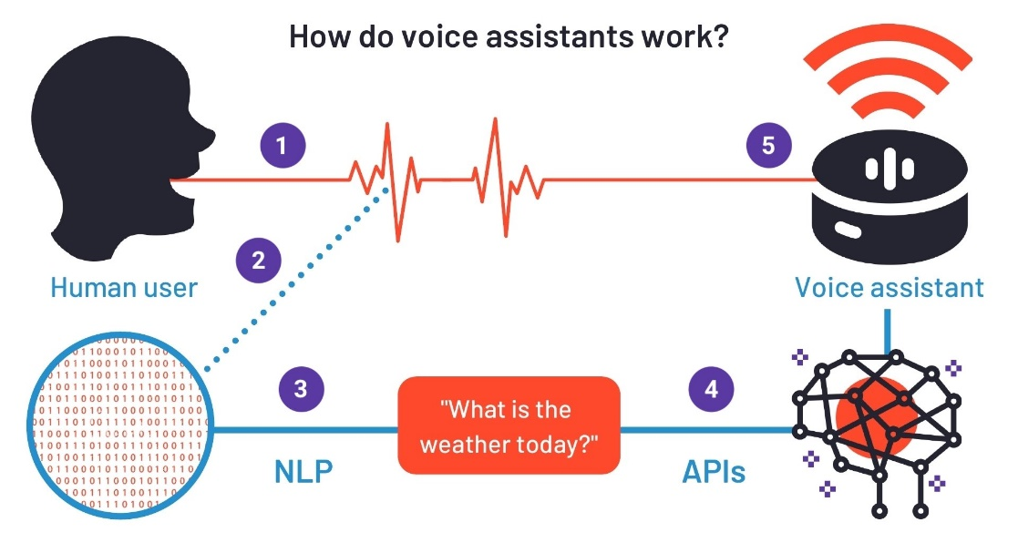
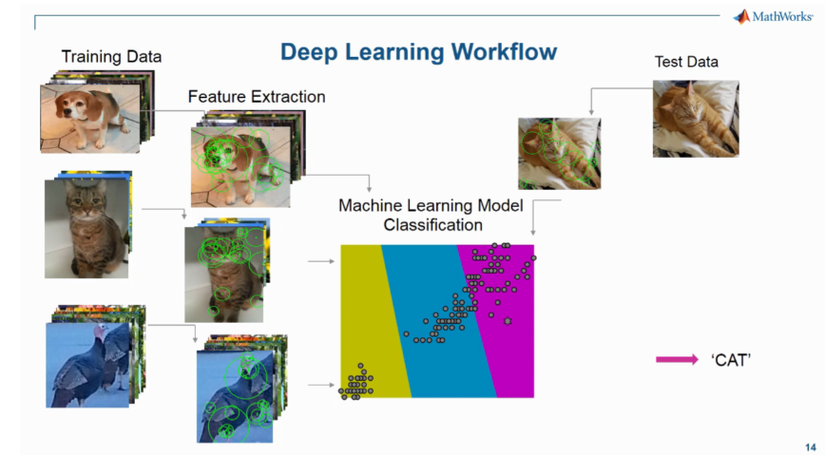


Deep Learning

Slide 5
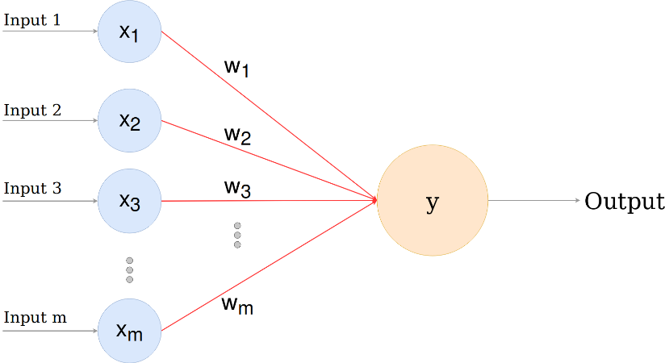
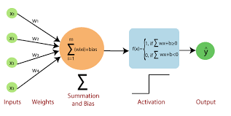
Perceptron
A single-layer perceptron is the basic unit of a neural network.
Architecture consists of a layer of input nodes fully connected to a single layer of output neuron
It produces a binary output based on a threshold.
A perceptron consists of input values, weights and a bias, a weighted sum and activation function
Notes:
https://sebastianraschka.com/faq/docs/diff-perceptron-adaline-neuralnet.html

Slide 6
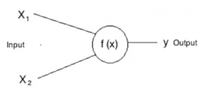
Features of Perceptron
Neuron
Each neuron is a mathematical operation that takes it’s inputs, multiplies them by their weights and then passes the sum through the activation function for output.
Bias
Bias is just like an intercept (constant) added in a linear equation.
It is an additional parameter in the Neural Network which is used to adjust the output along with the weighted sum of the inputs to the neuron.
It increases the flexibility of the model to fit given data.
Bias is equal to negative of threshold require to activate (trigger) neuron
Weights
Weights are the coefficients of the variables in the equations equation
Negative weights reduce the value of an output and vice-versa for positive weights
output = sum (weights * inputs) + bias
Notes:
https://www.analyticsvidhya.com/blog/2021/03/basics-of-neural-network/

Slide 7
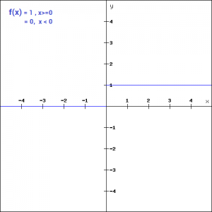
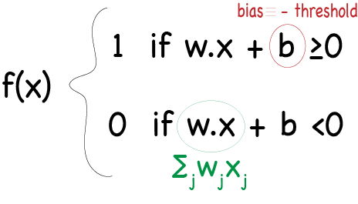
How Perceptron Works
Multiply all the inputs by their weights w and add them together referred as weighted sum: ∑ wj xj
Add bias to it ∑ wj*xj +bias to create a linear combination of weight and bias
Apply the activation function, in other words, determine whether the linear combination is greater than a threshold value.
Perceptron uses a threshold (Binary step function) as an activation function
If sum is greater than a threshold value, where -threshold is equivalent to bias, assign 1 ,if less then threshold then assign 0 as an output.
Notes:
https://www.analyticsvidhya.com/blog/2021/03/basics-of-neural-network/
https://www.quora.com/What-is-the-difference-between-the-neurons-in-an-artificial-neural-network-ANN-and-perceptrons
https://sebastianraschka.com/faq/docs/diff-perceptron-adaline-neuralnet.html
https://www.analyticsvidhya.com/blog/2020/01/fundamentals-deep-learning-activation-functions-when-to-use-them/

Slide 8
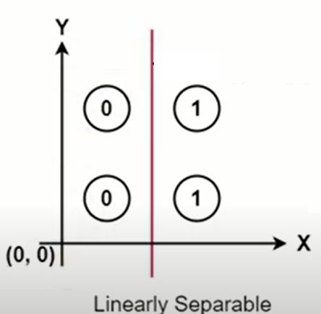
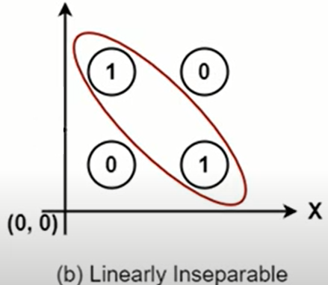
Neural Network (Deep Learning)
A Perceptron has limitation i.e. simple perceptron can only classify linearly separable data sets.
When layers of perceptron are combined together, they form a multilayer architecture, and this gives the required complexity of the neural network processing.

Slide 9
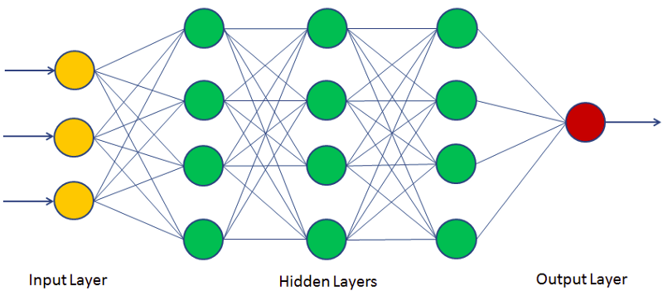
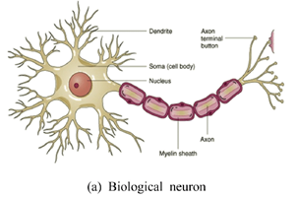
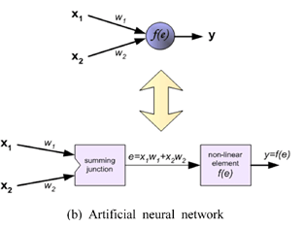
Neural Network (Deep Learning)
Neural Network is a network of neurons and other components that strengthen predictive power of model on complex data
An Artificial neural network is a very powerful machine learning mechanism which basically mimics how a human brain learns.
Direction of signal is along the Axon from Nucleus to synapse
Neural Networks support both classification & regression problems.

Slide 10
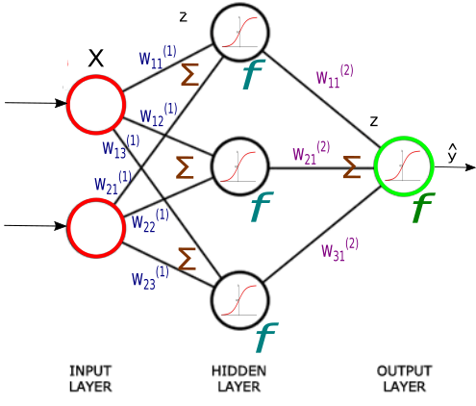
Neural Network Components
Layers : A neural network is made up of vertically stacked components called Layers.
Input Layer
Output Layer
Hidden Layer
Each input node is connected to each neuron of next hidden layer. Each neuron of
hidden layer is connected to each neuron of next hidden layer and so on. Each neuron
of last hidden layer is connected to output neuron.
Weights: Connection between nodes and neurons are assigned with individual weights
that get updated in training process.
Bias: Each neuron has a bias . The threshold (or bias) of a neuron is usually modelled as a weight which input is always 1. This bias is also learnable in training process
Notes:
https://www.youtube.com/watch?v=HetFihsXSys
https://www.analyticsvidhya.com/blog/2021/03/basics-of-neural-network/
https://www.quora.com/Artificial-Neural-Networks-How-are-thresholds-updated-by-backpropagation

Slide 11
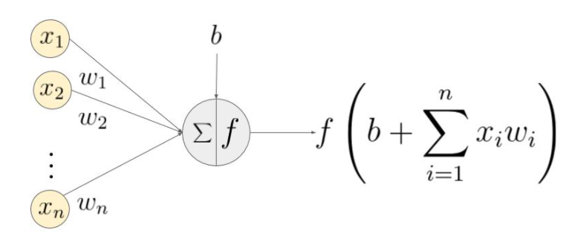
Features of Neural Network
Activation functions: Sometimes called a transfer function.
Activation functions bring non-linearity in neural network.
These are mathematical equations that determine the output of a neuron.
Activation function = f(∑(weights * inputs) + bias)
Activation functions also help normalize the output of each neuron to a range
between 1 and 0 or between -1 and 1.
NOTE: If we do not apply activation function then only linear transformation will be performed. Activation function introduced non-linear transformation to learn the complex patterns from the data
We will discuss types of activation function after working of NN

Slide 12
Artificial Neural Network
There are many types of neural networks available or that might be in the development stage. They can be classified depending on their structure, data flow, neurons used, their density, and layers
Perceptron
FeedForward Neural Network (FFNN)
Multi-Layer Perceptron (MLP)
RNN (Recurrent Neural Network)
CNN (Convolutional Neural Network)
Radial Basis Function Neural Network
LSTM (Long Short Term Memory)
Sequence to Sequence Models
Modular Neural Network
We have already seen perceptron.
Because of the limitation of backpropagations we do not use FFNN in deep learning. This neural network may or may not have the hidden layers
Hence, we will focus upon MLP to start our deep learning journey.
Notes:
https://www.researchgate.net/figure/The-feed-forward-multilayer-perceptron-artificial-neural-network-architecture-used-to_fig1_221226040
https://www.analyticsvidhya.com/blog/2020/01/fundamentals-deep-learning-activation-functions-when-to-use-them/
https://www.mygreatlearning.com/blog/types-of-neural-networks/

Slide 13
Multi-Layer Perceptron (MLP)
The term MLP is used ambiguously, sometimes loosely to mean any feedforward ANN
Every single node is connected to all neurons in the next layer which makes it a fully connected neural network.
Input and output layers are present having multiple hidden Layers i.e. at least three or more layers in total.
It has a bi-directional propagation i.e. forward propagation and backward propagation.
Used for deep learning [due to the presence of dense fully connected layers and back propagation]
Notes:
https://www.mygreatlearning.com/blog/types-of-neural-networks/
https://www.researchgate.net/figure/The-feed-forward-multilayer-perceptron-artificial-neural-network-architecture-used-to_fig1_221226040
https://www.analyticsvidhya.com/blog/2020/01/fundamentals-deep-learning-activation-functions-when-to-use-them/

Slide 14
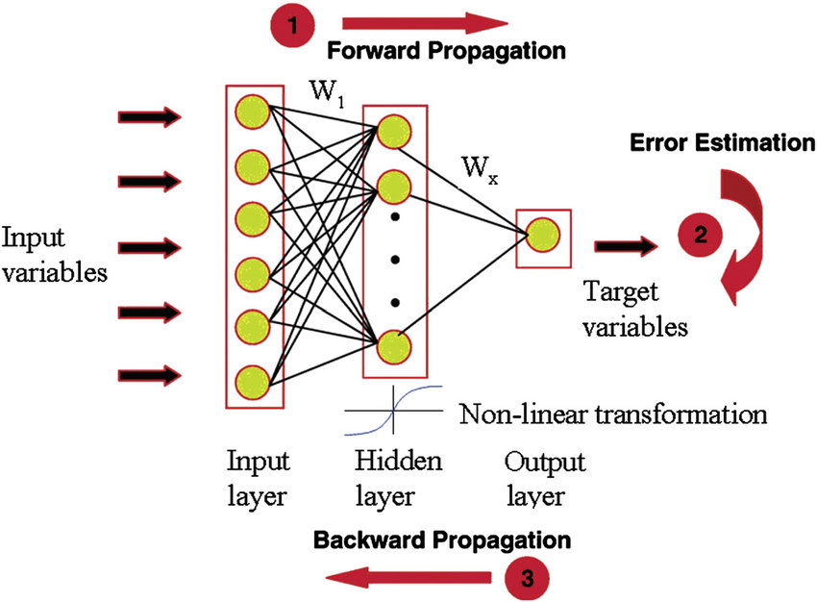
How MLP works
1. Define input variables (independent variables)
2. Randomly assign weights to all linkages between nodes and neurons
3. For first hidden layer apply activation function at each neuron using linearly combined input and calculate output for each neuron of first hidden layer
output = f(∑ wj xj +bias)
4. Output from the activation function passed to the next hidden layer and the same process is repeated till output layer. This forward movement of information is known as the forward propagation.
Notes:
https://www.researchgate.net/figure/The-feed-forward-multilayer-perceptron-artificial-neural-network-architecture-used-to_fig1_221226040
https://www.analyticsvidhya.com/blog/2020/01/fundamentals-deep-learning-activation-functions-when-to-use-them/
https://machinelearningmastery.com/neural-networks-crash-course/

Slide 15
How MLP works
Using the final output from the forward propagation, error is calculated.
Errors are passed back to all layers . This process is known as back-propagation. Purpose of this process is to update weights and biases of the network connections.
Considering one layer at a time, the weights are updated according to the amount that they contributed to the error.
Forward and Back propagation processes are repeated for all of the examples in your training data. This complete round for the entire training dataset is called an epoch.
A network may be trained for tens, hundreds or many thousands of epochs.
After Each epoch ,weights/bias get updated to reduce errors (losses). This optimization is achieved using various optimizers
Notes:
https://www.researchgate.net/figure/The-feed-forward-multilayer-perceptron-artificial-neural-network-architecture-used-to_fig1_221226040
https://www.analyticsvidhya.com/blog/2020/01/fundamentals-deep-learning-activation-functions-when-to-use-them/
https://machinelearningmastery.com/neural-networks-crash-course/

Slide 16
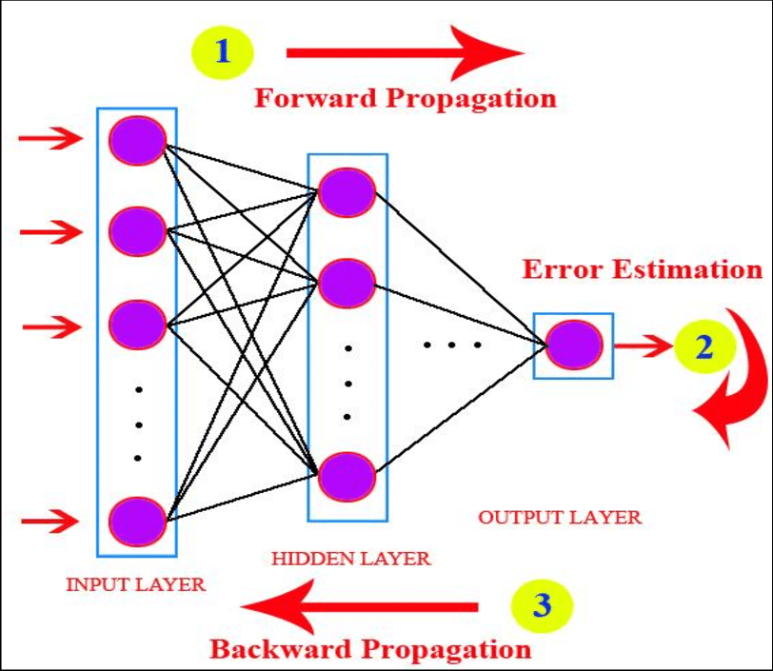
How MLP works
We can pass one example at a time or we can process multiple observations in a group called batch. Errors are saved at the time when all data finishes their forward and backward phase in a batch. Finally weights can be updated for network after each batch.
Size of batch normally is taken small to increase efficiency.
The amount that weights are updated is controlled by a configuration parameters called the learning rate. Often small rates are used such as 0.1 or 0.01 or smaller
Notes:
https://www.researchgate.net/figure/The-feed-forward-multilayer-perceptron-artificial-neural-network-architecture-used-to_fig1_221226040
https://www.analyticsvidhya.com/blog/2020/01/fundamentals-deep-learning-activation-functions-when-to-use-them/
https://machinelearningmastery.com/neural-networks-crash-course/

Slide 17
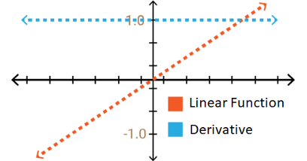
Features of Neural Network
Types of Activation functions
Binary Step Activation Function: Only two outputs (0 and 1)
f(x) = 1 if x > 0 else 0 if x < 0
2. Linear Activation Function
Y = mx+c
Ranges = -infinity to +infinity
Since gradient is constant (i.e. slope) weights and bias will be updated during the backprop but the updating factor (gradient) would be the same
If we apply this AF to all layers then the last layer will simply become a linear function of the first layer

Slide 18

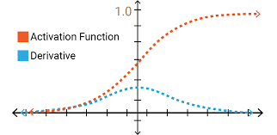
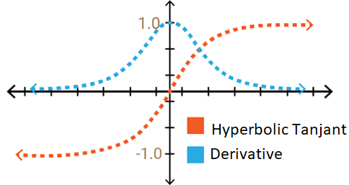

Features of Neural Network
3. Sigmoid Activation Function: It basically is a probabilistic approach towards decision making
Ranges in between 0 to 1
Derivative/gradient ranges between 0-0.25
Suffers vanishing gradient problem i.e. As the gradient value approaches zero, the network does not really learn
4. Hyperbolic Tangent Activation Function(Tanh):
Range -1 to 1 and gradient lies between 0-1
Suffers vanishing gradient problem
It is preferred over sigmoid since output is zero centric and optimization becomes easier during backpropagation process
Notes:
https://medium.com/@vinodhb95/activation-functions-and-its-types-8750f1287464

Slide 19
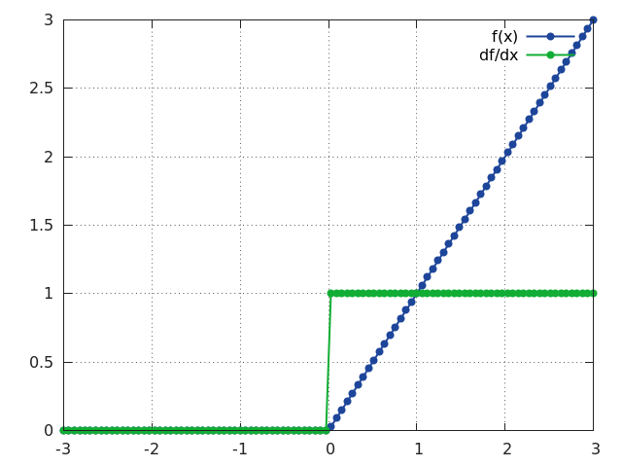

Features of Neural Network
5. ReLU (Rectified Linear unit) Activation function :
Rectified linear unit or ReLU is most widely used non-linear activation function.
Defined by (f(x) = max(0,x))
Range 0 to infinity
Gradient is 0 for x<0 and 1 for x>1
Solves vanishing gradient problem because many of the neurons have gradient = 1
Computationally efficient and fast convergence because
use of non-exponential function
It does not activate all the neurons at the same time i.e. if the output of the linear transformation is less than 0 then neuron will be deactivated in other words 0 will be passed to next layer
Notes:
https://medium.com/@vinodhb95/activation-functions-and-its-types-8750f1287464
https://stats.stackexchange.com/questions/176794/how-does-rectilinear-activation-function-solve-the-vanishing-gradient-problem-in

Slide 20
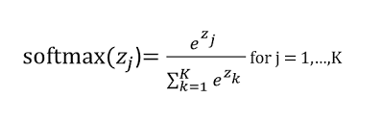

Features of Neural Network
6. Softmax Activation function :
Softmax can be described as the combination of multiple sigmoidal function. it is very useful to handle multi-class classification problems.
Softmax function returns the probability for a datapoint belonging to each individual class.
Sum of all values will be 1
Range 0 to infinity defined by (f(x) = max(0,x))
= softmax = input vector = standard exponential function for input vector = number of classes in the multi-class classifier = standard exponential function for output vector = standard exponential function for output vector
Notes:
https://medium.com/@vinodhb95/activation-functions-and-its-types-8750f1287464
https://stats.stackexchange.com/questions/176794/how-does-rectilinear-activation-function-solve-the-vanishing-gradient-problem-in

Slide 21
Features of Neural Network
Choose a Hidden Layer Activation Function
Sigmoid and tanh should be avoided in hidden layers to avoid vanishing gradient problem
ReLU function is most widely used today in hidden layers . it should be used only in hidden layers.
We can start with ReLU function and switch to other activation function if performance is not good using ReLU
For further advanced NN architecture following is the general practice for hidden layers:
1. ANN (MLP): ReLU activation function.
2. Convolutional Neural Network (CNN): ReLU activation function.
3. Recurrent Neural Network: Tanh and/or Sigmoid activation function.
Choose an Output Layer Activation Function
Regression Problem : One Node , Linear activation
Binary Classification Problem : One Node, Sigmoid Activation Function
Multiclass Classification Problem : One node per class Softmax Activation function
Notes:
https://machinelearningmastery.com/choose-an-activation-function-for-deep-learning/
https://www.analyticsvidhya.com/blog/2020/01/fundamentals-deep-learning-activation-functions-when-to-use-them/

Slide 22
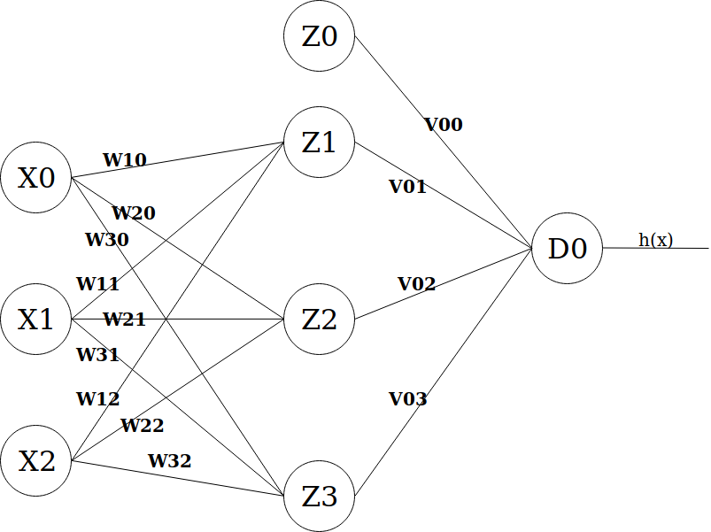

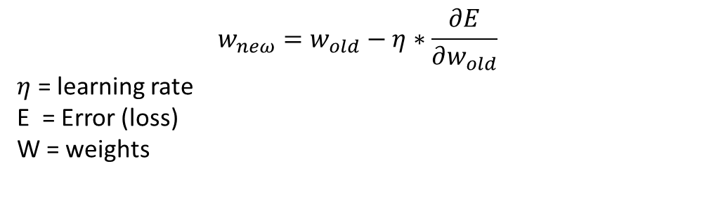
Update of Weights
Backpropagation, short for “backward propagation of errors”, is a mechanism used to update the weights using optimizer such as gradient descent.
${ w}_{neω}=w_{old}+Δw$
$$w_{neω}=w_{old}−η∗\frac{∂E}{∂w_{old}}$$
$η$ = learning rate
E = Error (loss)
W = weights
It calculates the gradient of the error function with respect to weights. This calculation proceeds backwards through the network.
Intuition : if derivative $\frac{∂E}{∂w_{old}}$is positive (i.e. effect of weighs on error is positive), then equation reduces weight by $η∗\frac{∂E}{∂w_{old}}$
Notes:
https://hmkcode.com/ai/backpropagation-step-by-step/

Slide 23
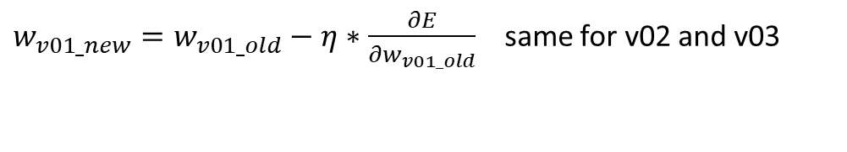
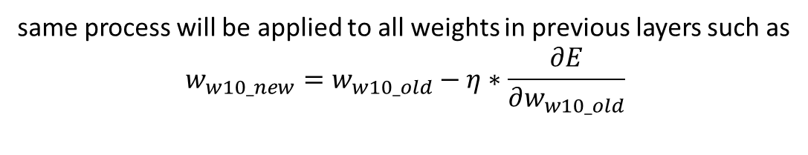
Update of Weights
Let’s say we have 1 input layer with 3 input ,
1 hidden layer with 3 neuron and 1 output neuron.
X0/X1/X2 are input for first hidden layer.
Z1/Z2/Z3 are output of first hidden layer and input for next layer (output)
h(x) is final output which is f(∑ Vj*Zj +bias) at last node
$w_{v01_new}=w_{v01_old}−η∗\frac{∂E}{∂w_{v01_old}}$ same for v02 and v03
same process will be applied to all weights in previous layers such as
$$w_{w10_new}=w_{w10_old}−η∗\frac{∂E}{∂w_{w10_old}}$$
Notes:
https://hmkcode.com/ai/backpropagation-step-by-step/

Slide 24
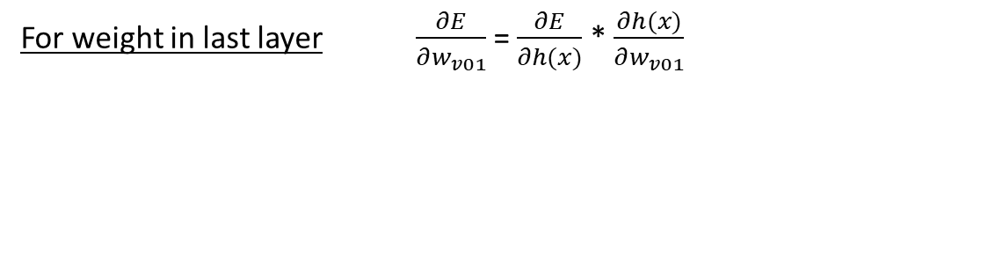
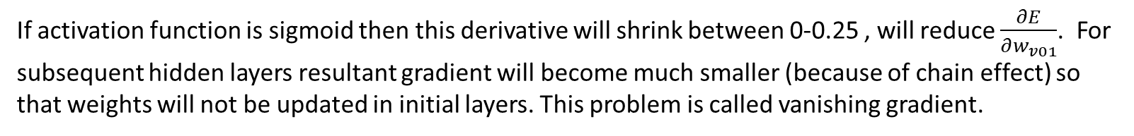

Update of Weights
$$w_{v01}=w_{v01}−η∗\frac{∂E}{∂w_{v01}}$$
The derivation of the error function is further evaluated by applying the chain rule as following :-
For weight in last layer $\frac{∂E}{∂w_{v01}}$= $\frac{∂E}{∂h(x)}$ * $\frac{∂h(x)}{∂w_{v01}}$
$\frac{∂E}{∂w_{v01}}$= $\frac{∂E}{∂h(x)}$ * $\frac{∂h(x)}{∂(\text{∑}\text{Vj}\text{∗}\text{Zj}\text{+}\text{bias})}$ * $\frac{∂(\text{∑}\text{Vj}\text{∗}\text{Zj}\text{+}\text{bias})}{∂w_{v01}}$
Derivative of activation function at output neuron D0
Linear Combination I/P
If activation function is sigmoid then this derivative will shrink between 0-0.25 , will reduce $\frac{∂E}{∂w_{v01}}$. For subsequent hidden layers resultant gradient will become much smaller (because of chain effect) so that weights will not be updated in initial layers. This problem is called vanishing gradient.
Notes:
https://hmkcode.com/ai/backpropagation-step-by-step/

Slide 25
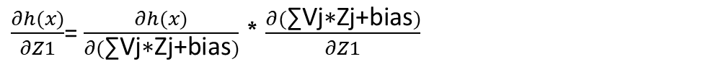

Vanishing Gradient Problem
if the derivatives are small then the gradient will decrease exponentially as we propagate through the model until it eventually vanishes, and this is the vanishing gradient problem.
For weights in first layer $\frac{∂E}{∂w_{w10}}$= $\frac{∂E}{∂h(x)}$ * $\frac{∂h(x)}{∂w_{w10}}$
$\frac{∂E}{∂w_{w10}}$= $\frac{∂E}{∂h(x)}$ *$\frac{∂h(x)}{∂Z1} ∗$ $\frac{∂Z1}{∂w_{w10}}$
Derivative of activation function at output neuron D0
Derivative of activation function at output neuron Z1
$\frac{∂h(x)}{∂Z1}$= $\frac{∂h(x)}{∂(\text{∑}\text{Vj}\text{∗}\text{Zj}\text{+}\text{bias})}$ * $\frac{∂(\text{∑}\text{Vj}\text{∗}\text{Zj}\text{+}\text{bias})}{∂Z1}$
$\frac{∂Z1}{∂w_{w10}}$= $\frac{∂Z1}{∂(\text{∑ }\text{wj}\text{∗}\text{xj}\text{ +}\text{bias})}$ * $\frac{∂(\text{∑ }\text{wj}\text{∗}\text{xj}\text{ +}\text{bias})}{∂w_{w10}}$
It can cause slow training of network.
We can avoid this problem by reducing number of layers or using ReLU in hidden layers.
Notes:
https://towardsdatascience.com/the-vanishing-exploding-gradient-problem-in-deep-neural-networks-191358470c11

Slide 26
Disadvantages of Neural Network
Good predictive performance but considered a “black box” prediction machine, with no insight into relationships between predictors and outcome
Heavy computational requirements if there are many variables (additional variables dramatically increase the number of weights to calculate)

Slide 27
Hyper parameter Tuning
hidden_layer_sizes tuple, length = n_layers - 2, default=(100,)
The I’th element represents the number of neurons in the I’th hidden layer.
activation{‘identity’, ‘logistic’, ‘tanh’, ‘relu’}, default=’relu’
Activation function for the hidden layer.
‘identity’, no-op activation, useful to implement linear bottleneck, returns f(x) = x
‘logistic’, the logistic sigmoid function, returns f(x) = 1 / (1 + exp(-x)).
‘tanh’, the hyperbolic tan function, returns f(x) = tanh(x).
‘relu’, the rectified linear unit function, returns f(x) = max(0, x)
solver{‘lbfgs’, ‘sgd’, ‘adam’}, default=’adam’
The solver for weight optimization.
‘lbfgs’ is an optimizer in the family of quasi-Newton methods.
‘sgd’ refers to stochastic gradient descent.
‘adam’ refers to a stochastic gradient-based optimizer

Slide 28
Hyper parameter Tuning
Alpha float, default=0.0001
L2 penalty (regularization term) parameter.
batch_size int, default=’auto’
Size of minibatches for stochastic optimizers. When set to “auto”, batch_size=min(200, n_samples)
learning_rate{‘constant’, ‘invscaling’, ‘adaptive’}, default=’constant’
Learning rate schedule for weight updates.
‘constant’ is a constant learning rate given by ‘learning_rate_init’.
‘invscaling’ gradually decreases the learning rate at each time step ‘t’ using an inverse scaling exponent of ‘power_t’. effective_learning_rate = learning_rate_init / pow(t, power_t)
‘adaptive’ keeps the learning rate constant to ‘learning_rate_init’ as long as training loss keeps decreasing.
Only used when solver='sgd'.

Slide 29
Game
Game

Slide 30
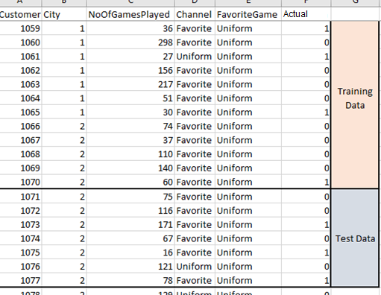
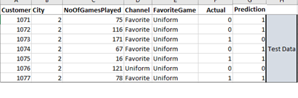
Performance Validation
Performance validation of Neural Network
Modelling on Training Data
ML Model
Apply on Test Data
Prediction

Slide 31
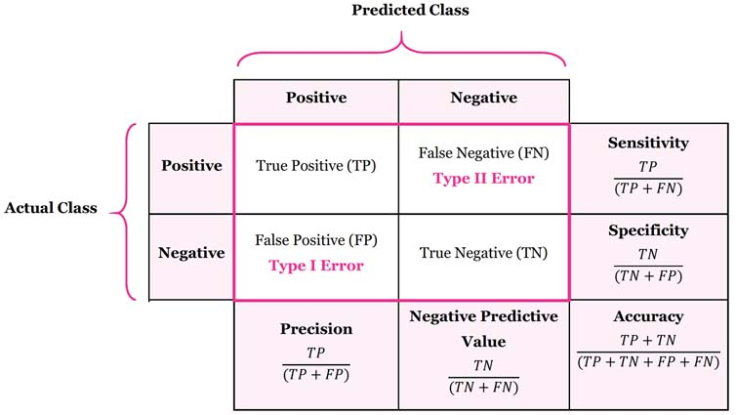
Model Evaluation Metrics
The various metrics used to evaluate the results of the prediction are :
Accuracy
Precision
Recall
Area Under ROC Curve
MAPE/ MAD/ RMSE (For Regressors)

